Slide 1
The coming era of on demand marketing
Team 1
Lee Chien Wei (A0120503A)
Edwin Tam Wei Ching (A0178396J)
Lin JunLiang (A0178295M)
Chee Jiawei (A0082949M)
Goh Yu Chen (A0178437R)

Slide 2
“…consumers will judge brands by their ability to deliver heighted experiences— interactions, literally anywhere, that offer high levels of value and are radically customized and easy to access—along the consumer decision journey
Notes:
The entire article can be summed up in 1 paragraph

Slide 3
“…consumers will judge brands by their ability to deliver heighted experiences— interactions, literally anywhere, that offer high levels of value and are radically customized and easy to access—along the consumer decision journey
TL;DR
Notes:
Too long don’t want to read? Here’s a few key phrases…
<READ KEY PHRASES>
It means that

Slide 4
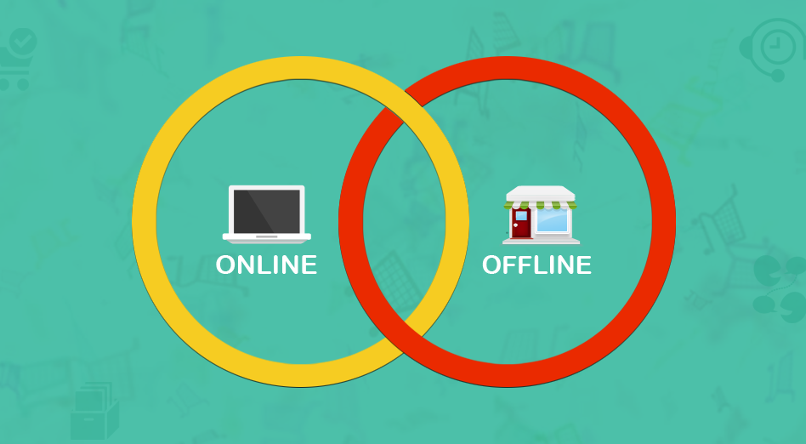
Real Time Personalized Consumer Experience (CX)
Notes:
Online and offline activities are now bridged by real-time, personalised customer Experience (CX)
Of which, there are 4 dimensions…

Slide 5
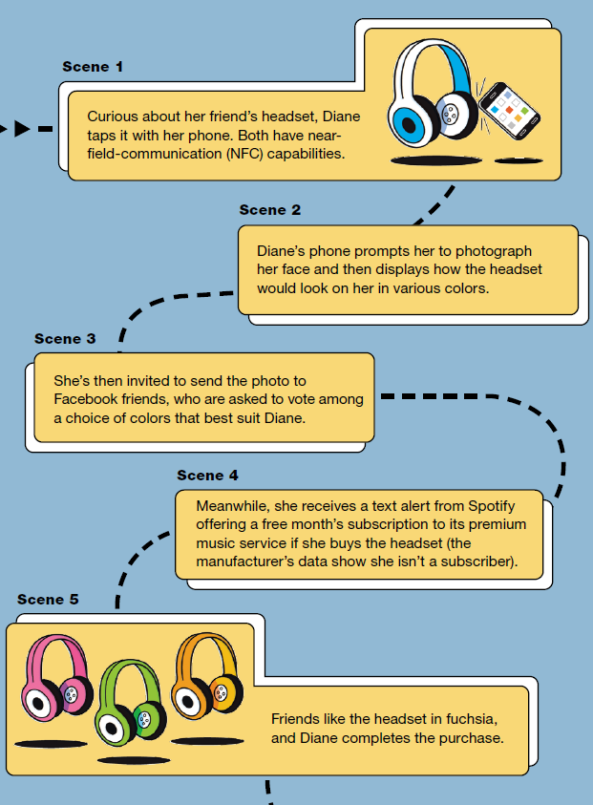
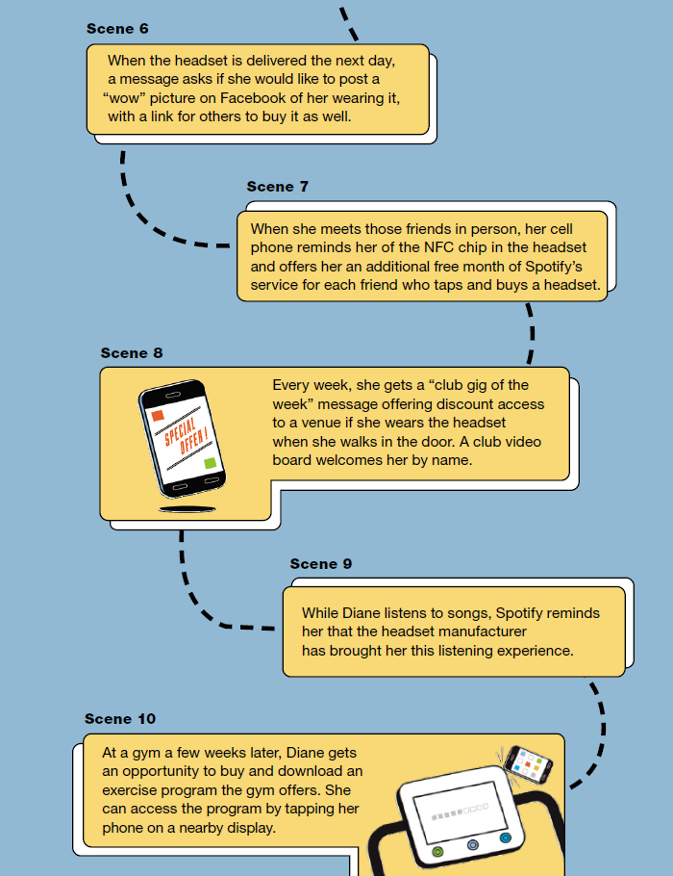
4 areas of consumer demands
Now
Now: Interact anywhere at any time.
Can I: Do new things in ways that create value for them.
For me: Expect all data stored about them to be targeted precisely to their needs or used to personalize what they experience.
Simply: They will expect all interactions to be easy.
Simply
For me
Can I
Notes:
This will take time
Now…
Can I…
For me…
Simply or simplify…

Slide 6
What Do We Think About
On Demand Marketing?
Now: Interact anywhere at any time.
Can I: Do new things in ways that create value for them.
For me: Expect all data stored about them to be targeted precisely to their needs or used to personalize what they experience.
Simply: They will expect all interactions to be easy.

Slide 7

What Do We Think About
On Demand Marketing?
We It!!

Slide 8
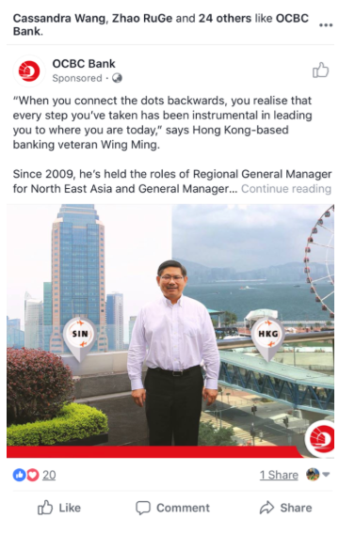
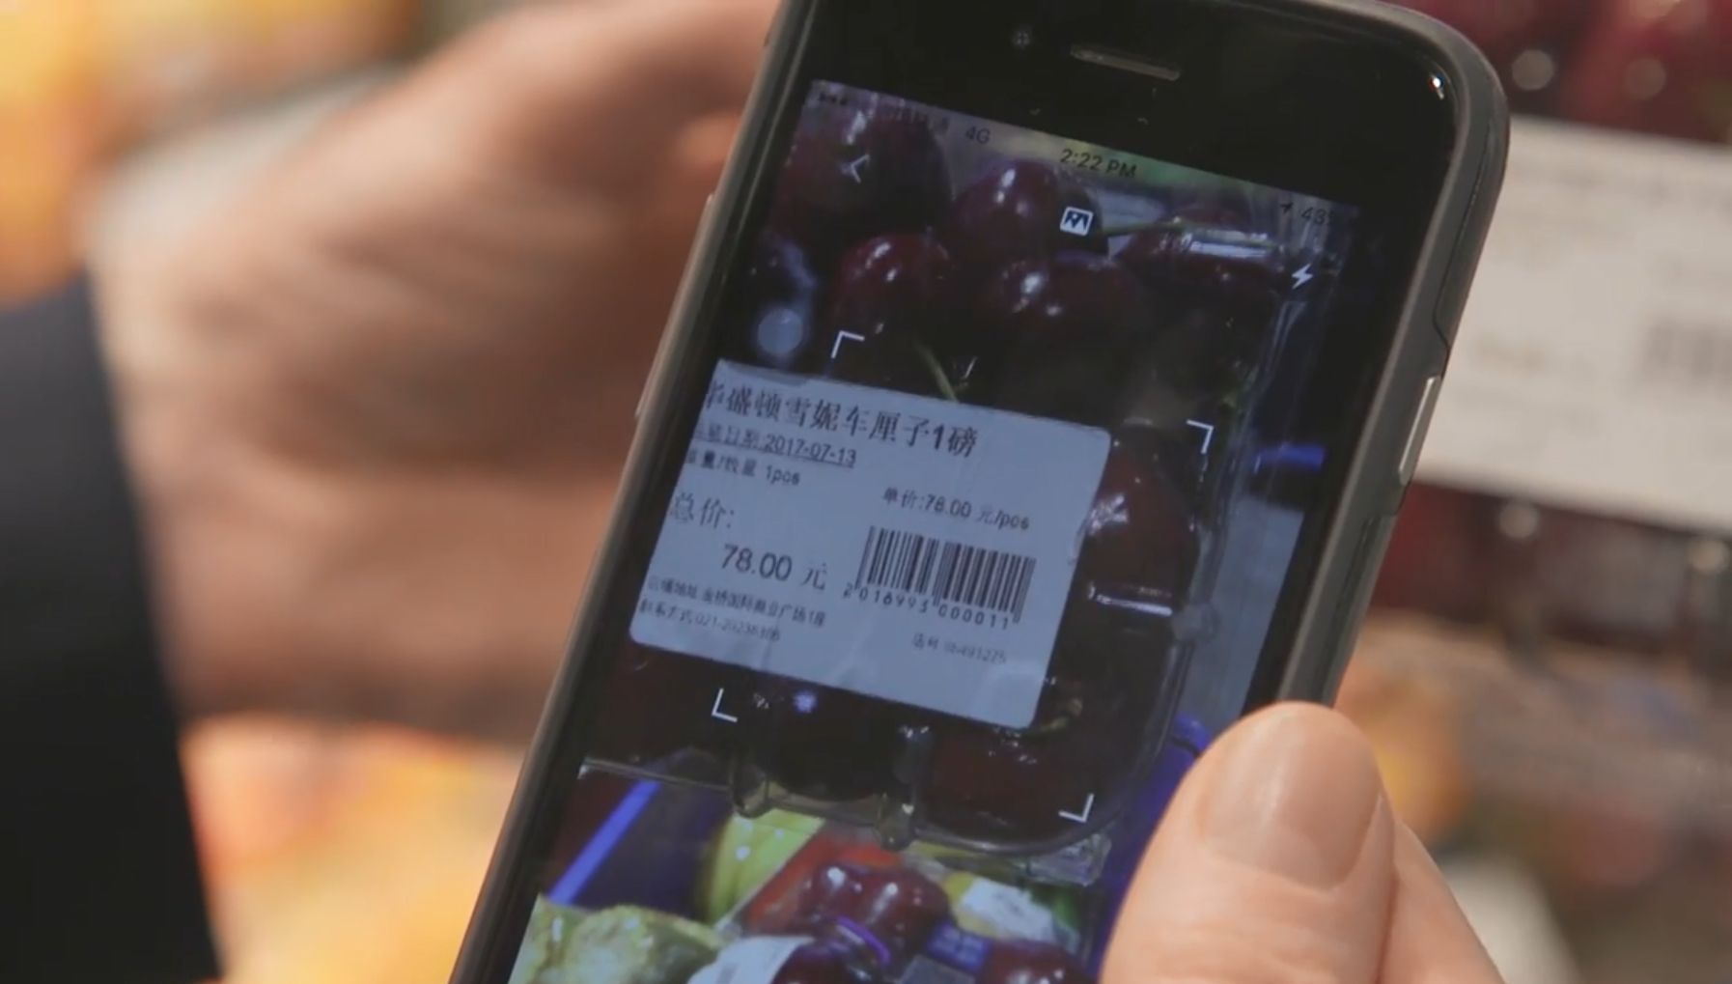


“What my friends like is also what I like. I like seeing what they like – so I can like what they like”
“Scan, see where it’s from, get suggestions that go with it, and buy – through the app in a retail shop"
For me
Now
Can I
For me
Simply
http://www.alizila.com/video/take-tour-hema-supermarket-experience-new-retail/
Notes:
This will take time
Left: Facebook remarketing which shows what our friends like.
What they like is what we like.
Right: Hema is Alipay’s offline grocery shop. Everything is done through the Alipay.
You can scan fruits to see its origins; receive suggestions of complementary ingredients; and then buy it with your app.
Why not just app it? Because nothing beats feeling up the fruit.

Slide 9
But…

Slide 10

How in the world can we do
On Demand Marketing???
Understand, Speculate, Design Experiences
Challenge Touchpoint delivery processes
Align execs around a data strategy
Notes:
How can we do on Demand marketing?
The article also suggests 3 ways: Read off the slide

Slide 11
How in the world can we do
On Demand Marketing???
Understand, Speculate, Design Experiences
Challenge Touchpoint delivery processes
Align execs around a data strategy
Notes:
Truthfully, we don’t think it’s all that helpful.

Slide 12

How in the world can we do
On Demand Marketing???
Understand, Speculate, Design Experiences
Challenge Touchpoint delivery processes
Align execs around a data strategy
But politics, capability, myopia and turf wars usually torpedo these efforts
It’s changing with specialist roles such as Head of Data & Strategy
Notes:
Politics & incompetence kill off On-demand marketing efforts before they can even get started.
But companies are creating special roles Head of Data & Strategy with the authority to push things through.

Slide 13
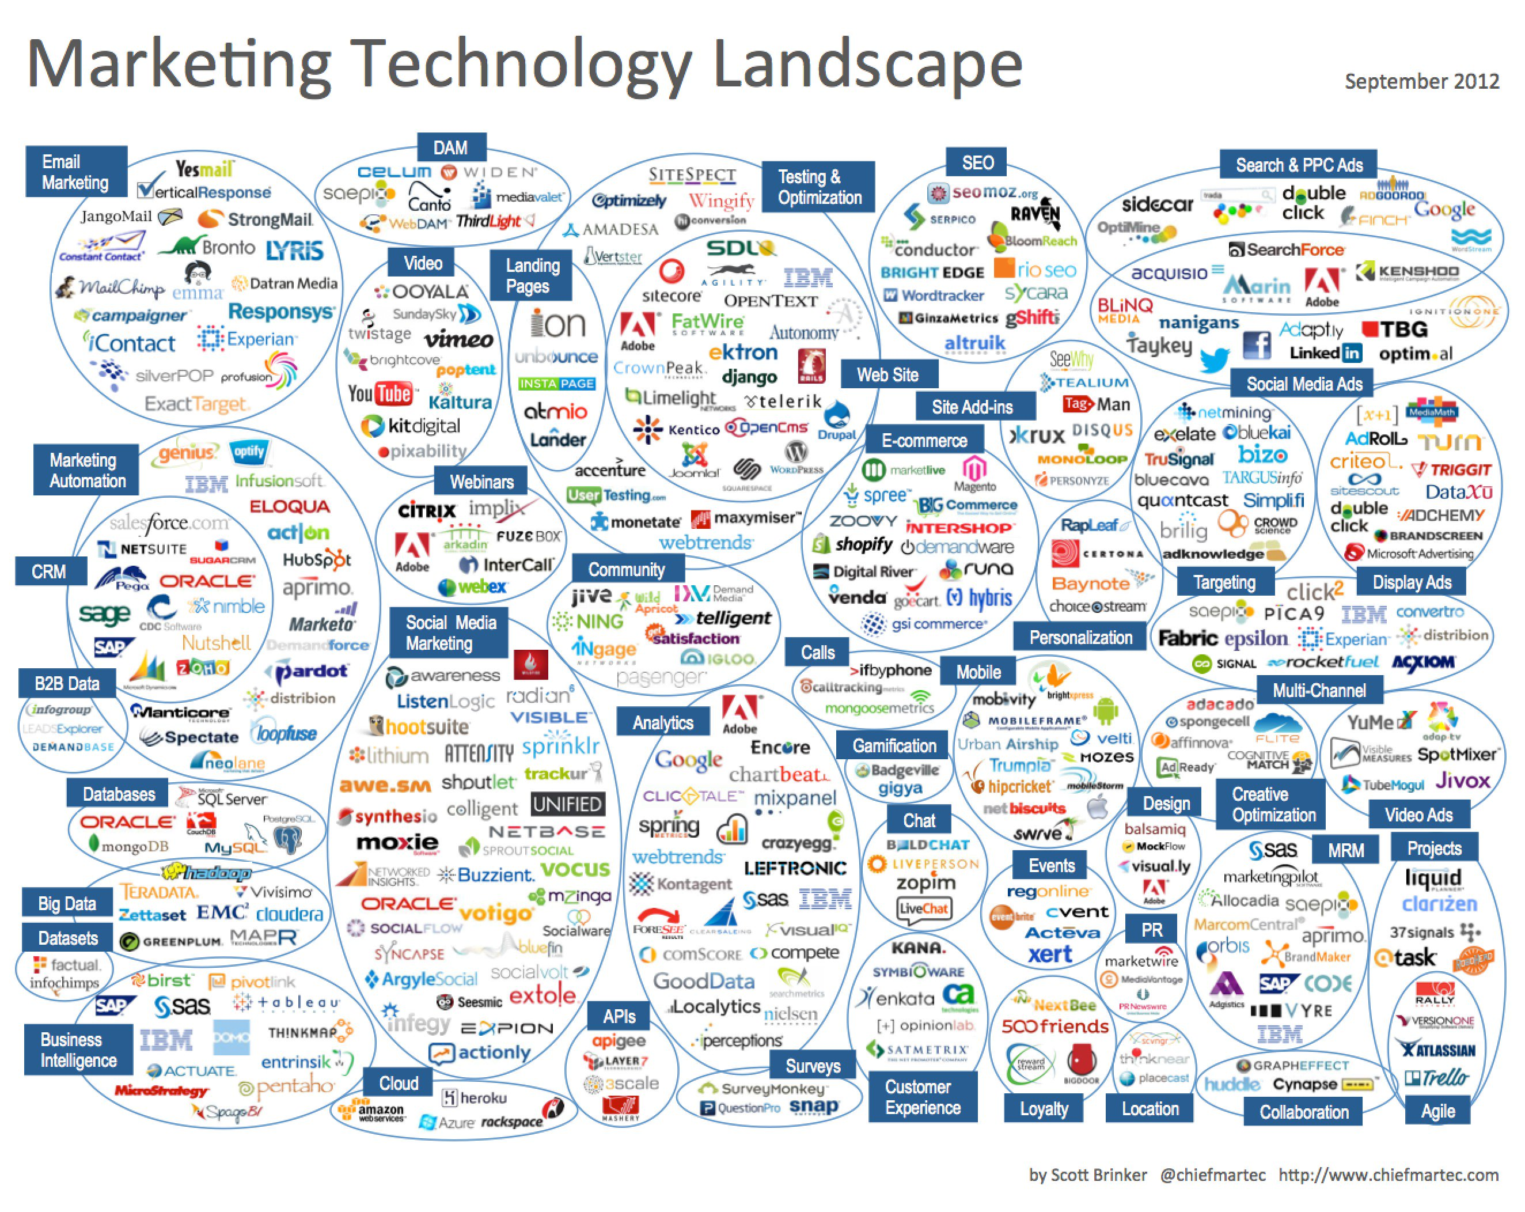
How in the world can we do
On Demand Marketing???
Understand, Speculate, Design Experiences
Challenge Touchpoint delivery processes
The Technology exists. But what do we use and how do we stack it up?
Align execs around a data strategy
Notes:
Technology isn’t the problem.
But there’s so many! What do we use and how do we stack them up?

Slide 14
In short
How???
We
but
Notes:
Soooo….

